Slide 1
Project Report
Name :- Rahul , Nikhil , Sumit , Udit
Project Name:- Tailer Management System

Slide 2
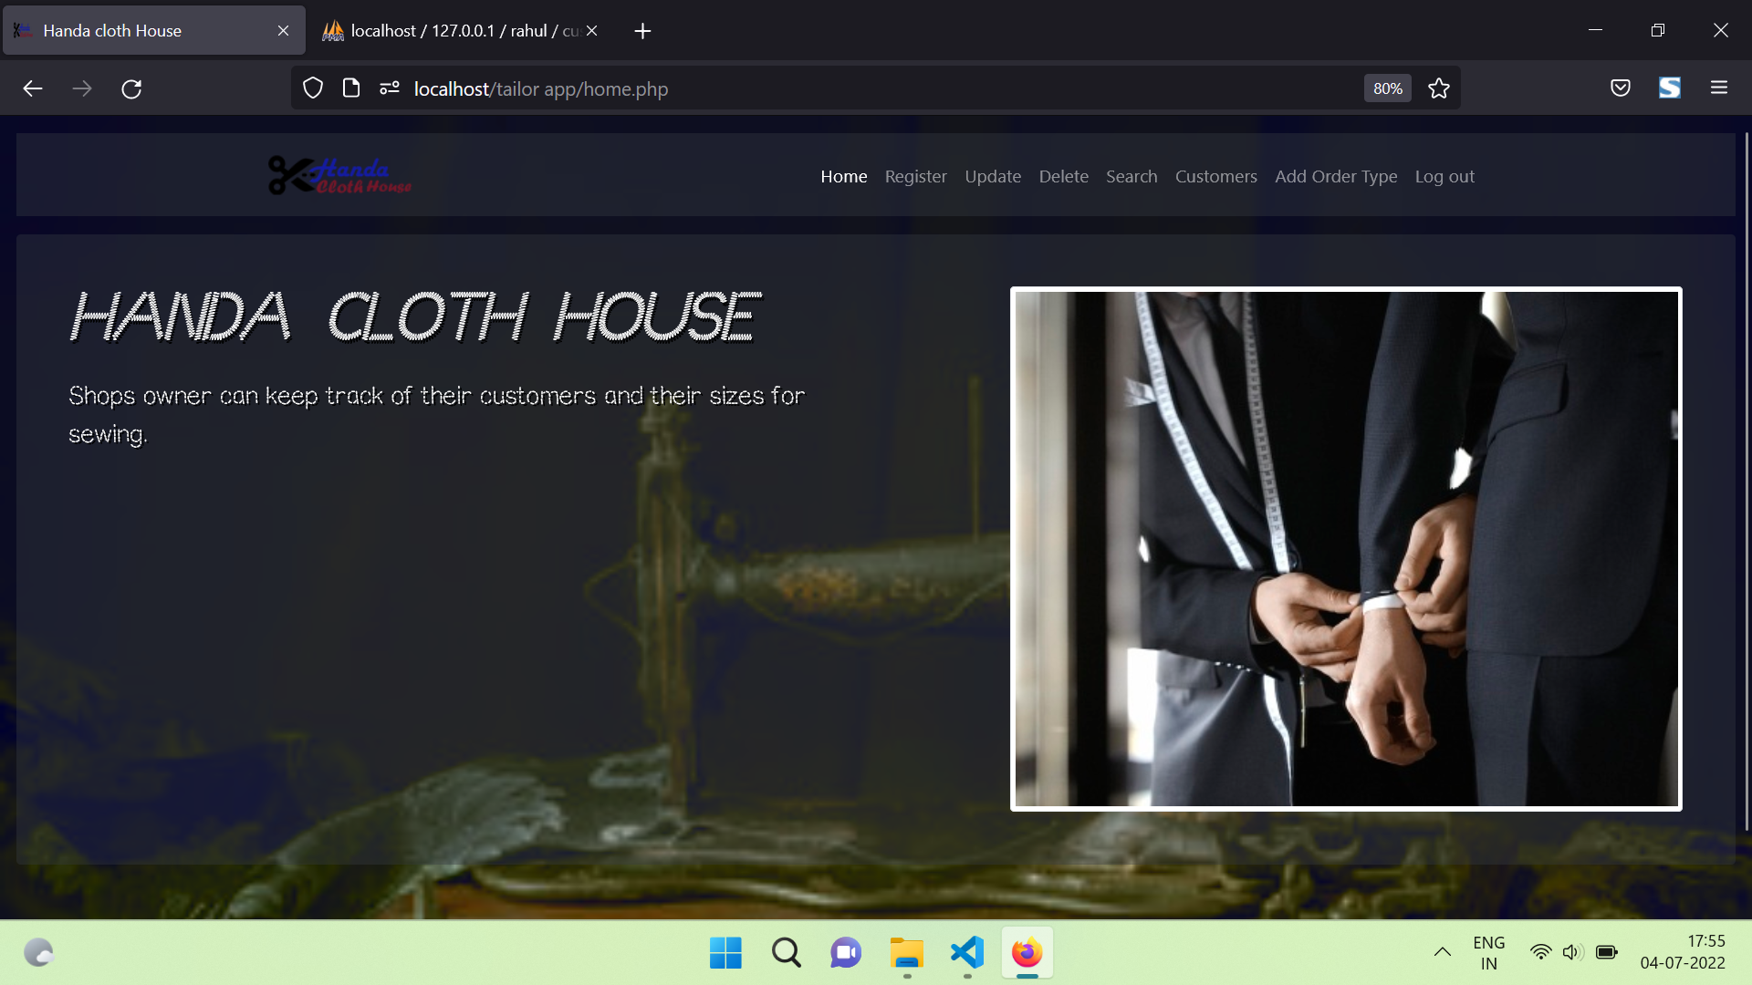
This is the Home page of our application.Which has one navigation menu bar to navigate through the project.

Slide 3
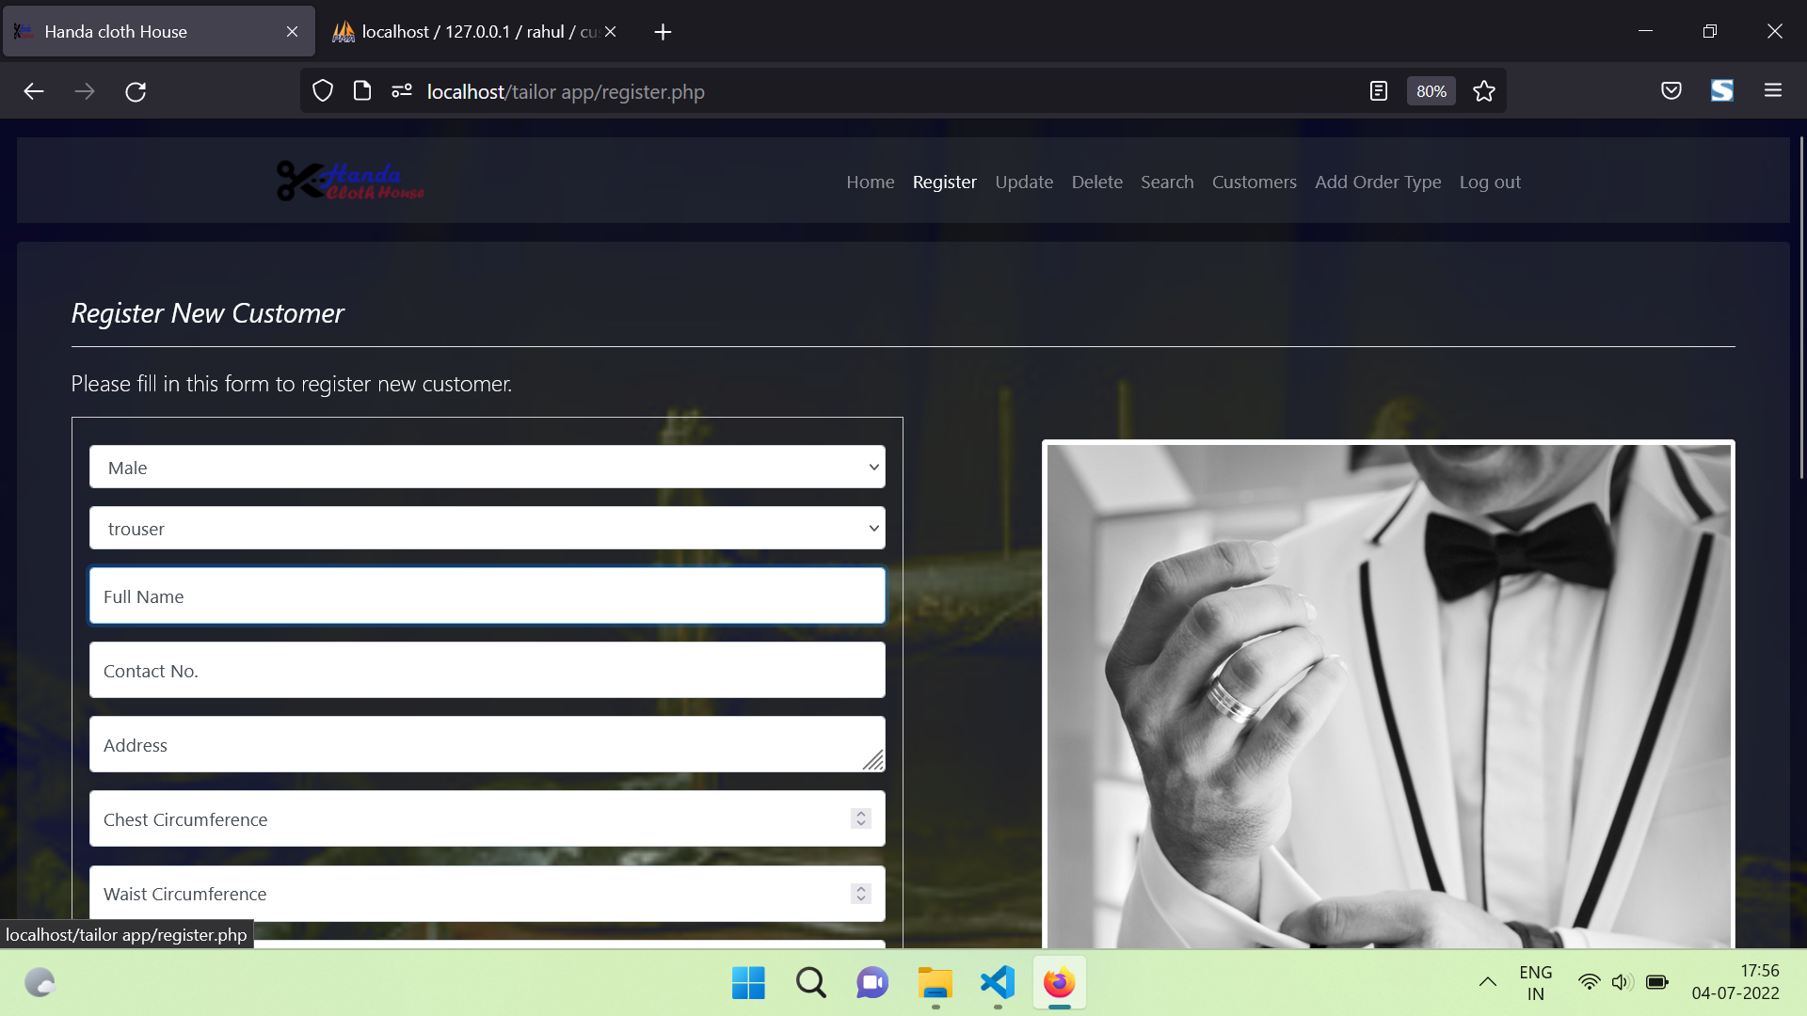
This is the registration page of out application once the new clients will come then we can register them from here .

Slide 4
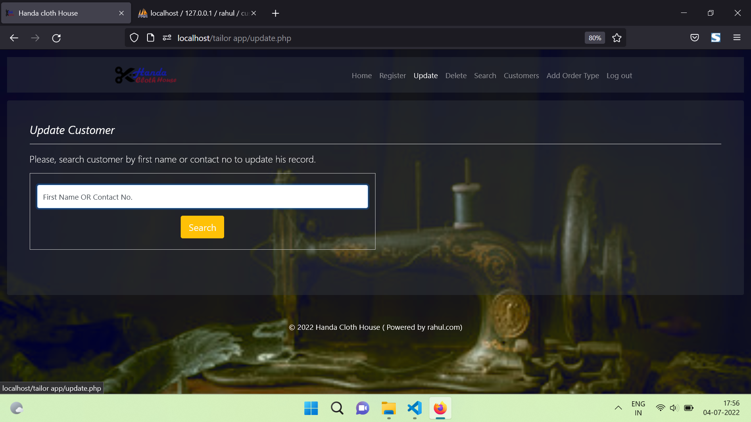
We can Update the existing user data from here . Here , we can search the user Live

Slide 5
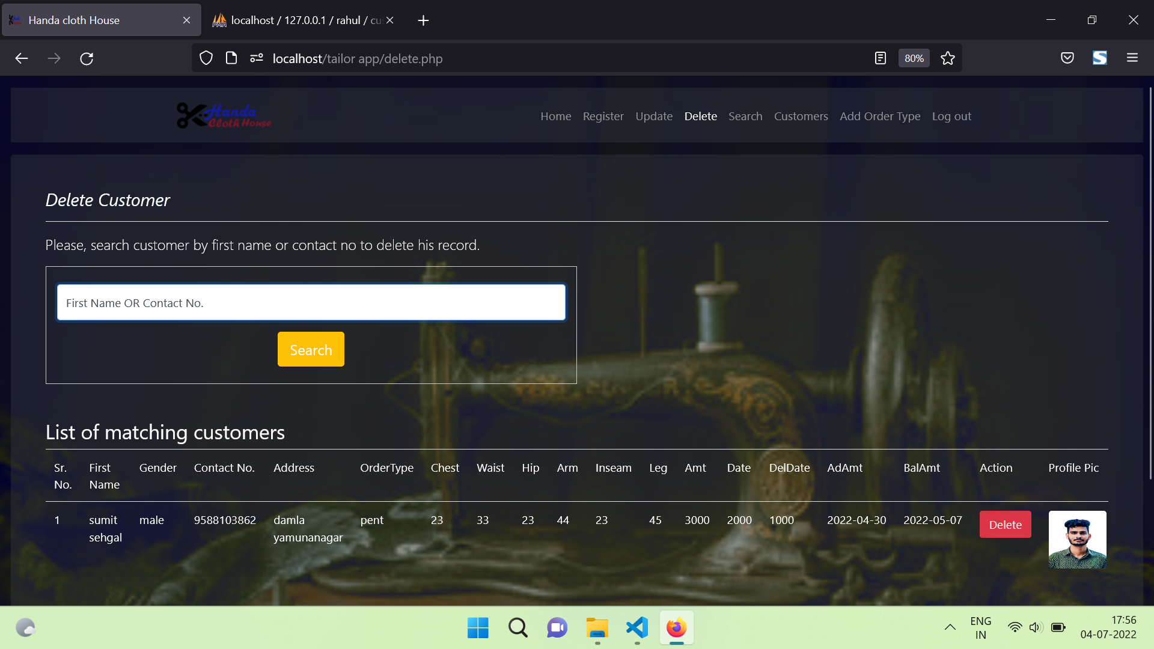
Once we search the data then here we can see the record of the User .

Slide 6
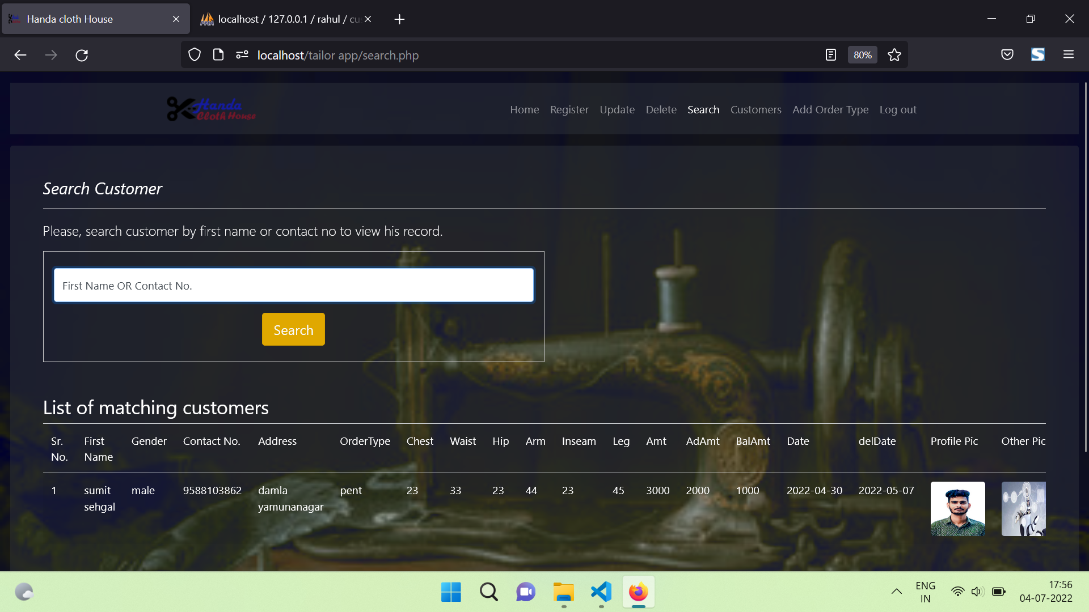

Slide 7
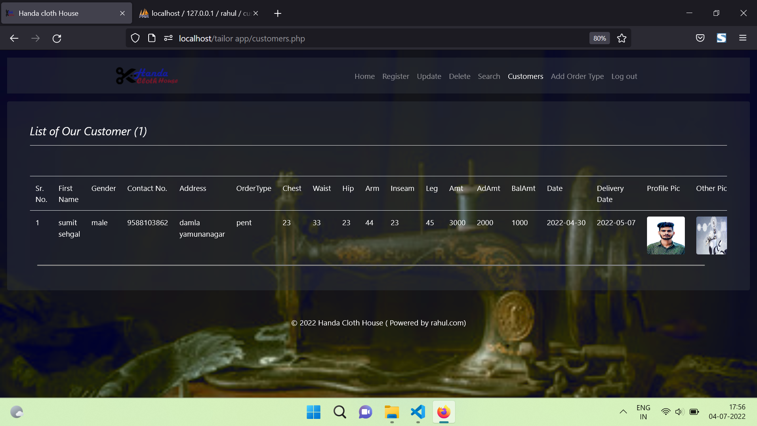

Slide 8
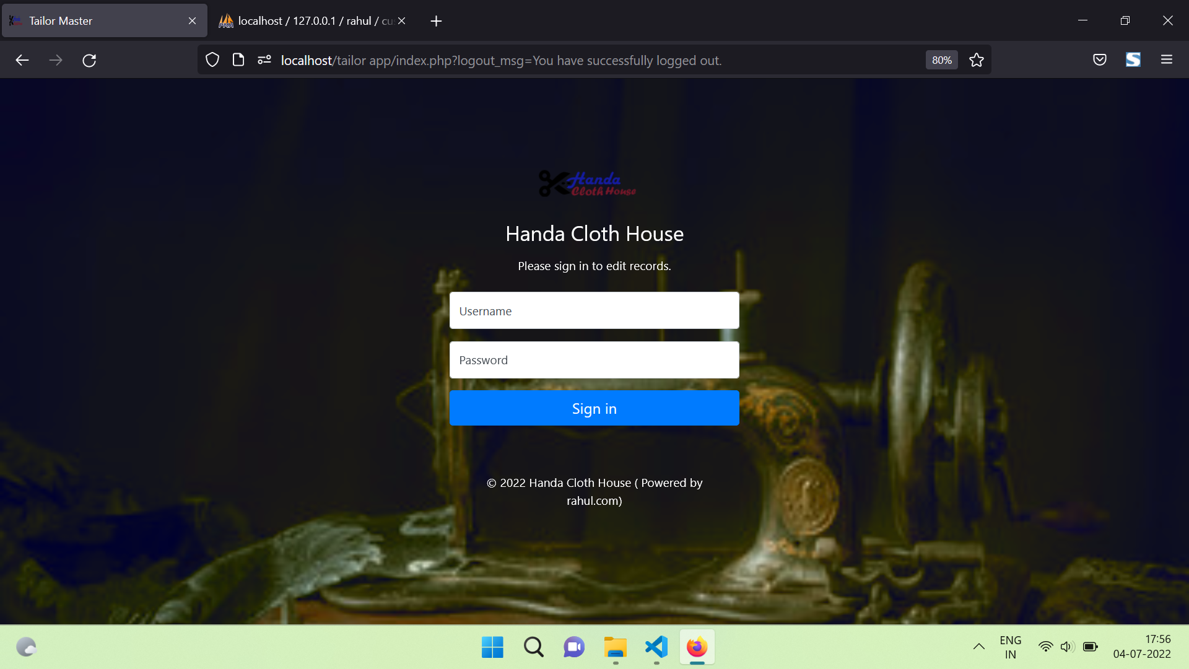
This is the Login page for the user .

